Slide 1
Introduction to Computer
Chapter:4
Prepared By:
Mehedi Hasan Imran
Lecturer, Dept. of Information & Communication Engineering
Bangladesh Army University of Engineering and Technology

Slide 2
Generations of Computers
First Generation Computers: Vacuum Tubes (1940-1956)
Main electronic component | Vacuum tube.
Programming language | Machine language.
Main memory | Magnetic tapes and magnetic drums.
Input/output devices | Paper tape and punched cards.
Speed and size | Very slow and very large in size (often taking up entire room).
Examples of the first generation | IBM 650, IBM 701, ENIAC, UNIVAC1, etc.

Slide 3
Second Generation Computers: Transistors (1956-1963)
Main electronic component | Transistor.
Programming language | Machine language and assembly language.
Memory | Magnetic core and magnetic tape/disk.
Input/output devices | Magnetic tape and punched cards.
Power and size | Smaller in size, low power consumption, and generated less heat (in comparison with the first generation computers).
Examples of second generation | PDP-8, IBM1400 series, IBM 7090 and 7094, UNIVAC 1107, CDC 3600 etc.

Slide 4
Third Generation Computers (1964-1971)
Main electronic component | Integrated circuits (ICs)
Programming language | High-level language
Memory | Large magnetic core, magnetic tape/disk
Input / output devices | Magnetic tape, monitor, keyboard, printer, etc.
Examples of third generation | IBM 360, IBM 370, PDP-11, NCR 395, B6500, UNIVAC 1108, etc.

Slide 5
Fourth Generation Computers: Micro-processors (1971-Present)
Main electronic component | Very large-scale integration (VLSI) and the microprocessor (VLSI has thousands of transistors on a single microchip).
Memory | semiconductor memory (such as RAM, ROM, etc.)
Input/output devices | pointing devices, optical scanning, keyboard, monitor, printer, etc.
Examples of fourth generation | IBM PC, STAR 1000, APPLE II, Apple Macintosh, Alter 8800, etc.

Slide 6
Fifth Generation Computers
Main electronic component | Based on artificial intelligence, uses the Ultra Large-Scale Integration (ULSI) technology and parallel processing method (ULSI has millions of transistors on a single microchip and Parallel processing method use two or more microprocessors to run tasks simultaneously).
Language | Understand natural language (human language).
Size | Portable and small in size.
Input / output device | Trackpad (or touchpad), touchscreen, pen, speech input (recognize voice/speech), light scanner, printer, keyboard, monitor, mouse, etc.
Example of fifth generation | Desktops, laptops, tablets, smartphones, etc.

Slide 7
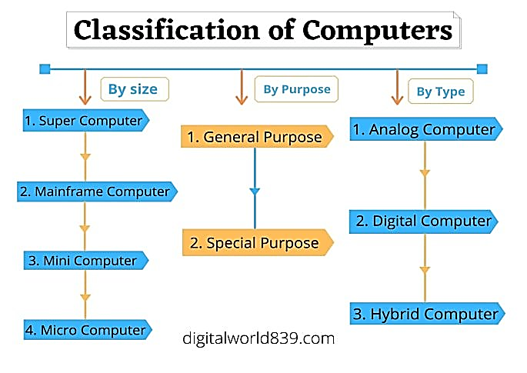

Slide 8
Super computers :
The super computers are the most high performing system. A supercomputer is a computer with a high level of performance compared to a general-purpose computer. The actual Performance of a supercomputer is measured in FLOPS instead of MIPS. All of the world’s fastest 500 supercomputers run Linux-based operating systems. Additional research is being conducted in China, the US, the EU, Taiwan and Japan to build even faster, more high performing and more technologically superior supercomputers. Supercomputers actually play an important role in the field of computation, and are used for intensive computation tasks in various fields, including quantum mechanics, weather forecasting, climate research, oil and gas exploration, molecular modeling, and physical simulations. and also Throughout the history, supercomputers have been essential in the field of the cryptanalysis.
eg: PARAM, jaguar, roadrunner.

Slide 9
Mainframe computers :
These are commonly called as big iron, they are usually used by big organizations for bulk data processing such as statics, census data processing, transaction processing and are widely used as the servers as these systems has a higher processing capability as compared to the other classes of computers, most of these mainframe architectures were established in 1960s, the research and development worked continuously over the years and the mainframes of today are far more better than the earlier ones, in size, capacity and efficiency.
Eg.: IBM z Series, System z9 and System z10 servers.

Slide 10
Mini computers :
These computers came into the market in mid 1960s and were sold at a much cheaper price than the main frames, they were actually designed for control, instrumentation, human interaction, and communication switching as distinct from calculation and record keeping, later they became very popular for personal uses with evolution.
In the 60s to describe the smaller computers that became possible with the use of transistors and core memory technologies, minimal instructions sets and less expensive peripherals such as the ubiquitous Teletype Model 33 ASR.They usually took up one or a few inch rack cabinets, compared with the large mainframes that could fill a room, there was a new term “MINICOMPUTERS” coined
Eg: Personal Laptop, PC etc.

Slide 11
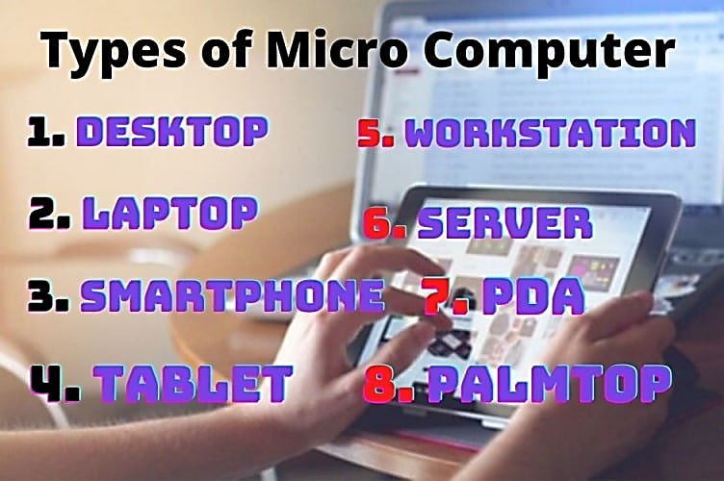
Micro computers :
A microcomputer is a small, relatively inexpensive computer with a microprocessor as its CPU. It includes a microprocessor, memory, and minimal I/O circuitry mounted on a single printed circuit board. The previous to these computers, mainframes and minicomputers, were comparatively much larger, hard to maintain and more expensive. They actually formed the foundation for present day microcomputers and smart gadgets that we use in day to day life.
Eg: Tablets, Smartwatches.

Slide 12
Computers on the Basis Purpose
General Purpose
General computers can do various everyday tasks such as writing a word processing letter, Document preparation, recording, financial analysis, Printing documents, creating databases, and calculations with accuracy and consistency.
The size, storage capacity, and cost of such computers are mainly less. The ability of these computers is limited in performing specialized tasks. Still, it has versatility and useful for serving people’s basic needs at home or in the workplace in the environment.
Examples:
Desktops, laptops, smartphones, and tablets are used on daily basis for general purposes.

Slide 13
Special Purpose:
These computers are designed to perform a particular or specialized task. The size, storage capacity, and cost of such computers mainly depend on the nature and size of the work. The function of these computers is consistent with any particular task.
The special computer needs specific and input and devices as well as a compatible motherboard with the processor to conduct work efficiently.
These computers are used for special purposes in weather forecasting, space research, agriculture, engineering, meteorology, satellite operation, traffic control, and research in chemical sciences.
Examples:
Automatic teller machines (ATM),
Washing machines,
Surveillance equipment,
Weather-forecasting simulators,
Traffic-control computers,
Defense-oriented applications,
Oil-exploration systems,
Military planes controlling computers.

Slide 14
Computers on the Basis of Hardware Design and Data Handling.
Analog :
An analog computer performs tasks using continuous data (the physical amount that changes continuously). Analog computers are used primarily to measure physical units like the voltage, pressure, electric current, temperature, and convert them into digits.
It is also used to measure and perform arithmetic calculations of numbers, the length of an object, or the amount of voltage that passes through a point in an electrical circuit. Analog computers obtain all their data from some measurement way.
Analog computers are mainly used in the fields of science and engineering. Analog computers are slow and equipped to measure things rather than countable or check.
The efficiency of this computer increases when we get the result of the data in graphs, etc. Analog Computers cannot store statistics.
They are used in the fields of technology, science, research, engineering, etc. Because quantities like voltage, pressure, electric current, temperature are used more in these areas, these types of computers give only approximate estimates.

Slide 15
Examples:
An analog computer installed on a petrol pump measures the amount of petrol coming out of the pump and appears in liters. And calculates its value. These quantities vary continuously while measuring the amount, such as the temperature of a human body changes consistently.
A simple clock, the vehicle’s speedometer, Voltmeter, etc. are examples of analog computing.

Slide 16
Digital Computer
As its name suggests, a digital computer represents the digital computer’s letters, numerical values, or any other special symbols. This computer is the computer that calculates the number for processing the data.
They run on electronic signs, and the binary numeral method Binary System 0 or 1 is used for calculation. Their speed is fast.
It can perform arithmetic operations such as addition, occurrence, subtraction, multiplication, or division and all types of logical(mathematical) operations. Today, most of the computers available in the market are digital computers.
Digital computers are built to bring the solution of equations to an almost unlimited precision, but in a bit slow manner compared to analog computers. To some extent, they all have similar components for receiving, processing, sorting, and transmitting data and use a relatively small number of essential functions to perform their tasks.
Digital computers use discrete electrical signals for operation rather than continuous electrical signals as analog computers have, making them the most common form of computers today because of their versatility, speed, and power.
The desktop or Laptop at our home is one the common and best example of a digital computer.

Slide 17
Other Examples of Digital Computers
Personal Desktop Computers,
Calculators,
Laptops, Smartphones, and Tablets,
Chromebooks,
Digital watch,
Accounting machines,
Workstations,
Digital clock, etc.

Slide 18
Difference between Analog Computer and Digital Computer :
01. Analog computers works with continuous values or these types of systems process continuous data. Digital computers works with discrete values or these types of systems process discrete data.
02. Speed of analog computers is less than the digital computers. Speed of digital computers is more than the analog computers.
03. Analog computer has very low or limited memory and it can store less amount of data. Digital computer has very big memory it can store large amount of data.
04. Analog computer has no state. Digital computer has On and Off these 2 steps.
05. Analog computers are less reliable than digital computers. Digital computers are more reliable than analog computers.
06. Its performance is comparatively low. Its performance is very high.
07. Its speed of processing is not so high. Its speed of processing is very high.
08. Analog computers depends upon physical variations. Digital computers does not depend upon physical variations.
09. It provides results with less accuracy as compared to digital computers. It provides results with higher accuracy as compared to analog computers.
10. Analog computers are difficult to use. Digital computers are not so difficult to use.

Slide 19
11. Analog computers have complex architecture. Digital computers do not have so complex architecture like analog computers.
12. Readability of analog computer is low. Readability of digital computer is high.
13. Analog computers show the result in terms of voltage signals. Digital computers show the result in computer display screen.
14. Analog computers employs analog encoding. Digital computers employs digital encoding.
15. Power consumption is high. Power consumption is low.
16. They are usually special purpose devices. It can be general purpose devices.
17. Examples includes analog clock and thermometer etc. Examples includes Digital laptop, digital camera, digital watches etc.

Slide 20
Hybrid Computer (Analog + Digital)
A combination of computers those are capable of inputting and outputting in both digital and analog signals. A hybrid computer system setup offers a cost effective method of performing complex simulations.
Applications of hybrid Computer:
Hybrid computers are most commonly used in vast industries, research centers, organizations, and manufacturing firms (where many equations need to be solved).
Also, the solutions and uses of hybrid computers have proved to be much more detailed, accurate, and useful. Hybrid computers are used in scientific calculations, for nations’ defense and radar systems as well.
Examples:
Auto Gasoline pump is the example of a hybrid computer, this device is installed on a petrol pump do not only to measure the amount of petrol but also to calculates its value, in this way It is capable of both functions i.e hybrid function.

Slide 21
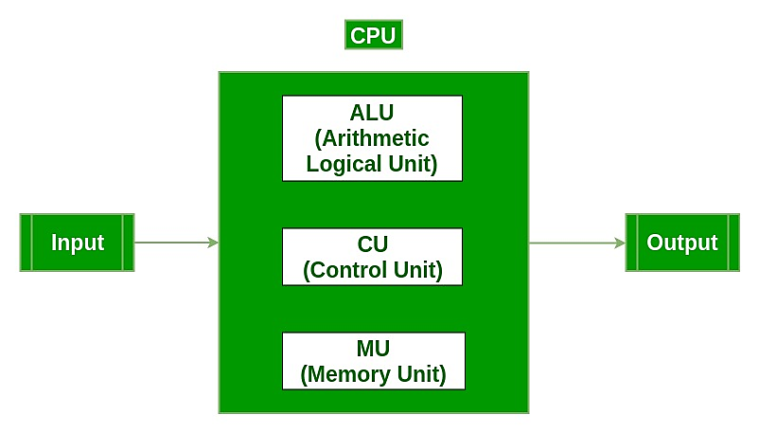
Functional Components of a Computer:
Input Unit :The input unit consists of input devices that are attached to the computer. These devices take input and convert it into binary language that the computer understands. Some of the common input devices are keyboard, mouse, joystick, scanner etc.

Slide 22
Central Processing Unit (CPU) : Once the information is entered into the computer by the input device, the processor processes it. The CPU is called the brain of the computer because it is the control center of the computer. It first fetches instructions from memory and then interprets them so as to know what is to be done. If required, data is fetched from memory or input device. Thereafter CPU executes or performs the required computation and then either stores the output or displays on the output device. The CPU has three main components which are responsible for different functions – Arithmetic Logic Unit (ALU), Control Unit (CU) and Memory registers
Arithmetic and Logic Unit (ALU) : The ALU, as its name suggests performs mathematical calculations and takes logical decisions. Arithmetic calculations include addition, subtraction, multiplication and division. Logical decisions involve comparison of two data items to see which one is larger or smaller or equal.
Control Unit : The Control unit coordinates and controls the data flow in and out of CPU and also controls all the operations of ALU, memory registers and also input/output units. It is also responsible for carrying out all the instructions stored in the program. It decodes the fetched instruction, interprets it and sends control signals to input/output devices until the required operation is done properly by ALU and memory.
Memory Registers : A register is a temporary unit of memory in the CPU. These are used to store the data which is directly used by the processor. Registers can be of different sizes(16 bit, 32 bit, 64 bit and so on) and each register inside the CPU has a specific function like storing data, storing an instruction, storing address of a location in memory etc. The user registers can be used by an assembly language programmer for storing operands, intermediate results etc. Accumulator (ACC) is the main register in the ALU and contains one of the operands of an operation to be performed in the ALU.

Slide 23
Memory : Memory attached to the CPU is used for storage of data and instructions and is called internal memory The internal memory is divided into many storage locations, each of which can store data or instructions. Each memory location is of the same size and has an address. With the help of the address, the computer can read any memory location easily without having to search the entire memory. when a program is executed, it’s data is copied to the internal memory and is stored in the memory till the end of the execution. The internal memory is also called the Primary memory or Main memory. This memory is also called as RAM, i.e. Random Access Memory. The time of access of data is independent of its location in memory, therefore this memory is also called Random Access memory (RAM). Read this for different types of RAMs
Output Unit : The output unit consists of output devices that are attached with the computer. It converts the binary data coming from CPU to human understandable form. The common output devices are monitor, printer, plotter etc.

Slide 24
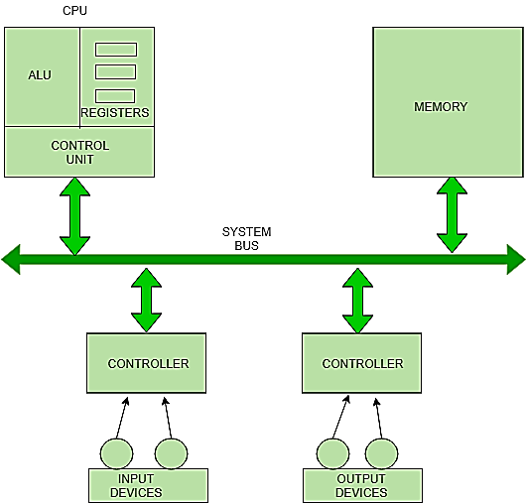
Interconnection between Functional Components
A computer consists of input unit that takes input, a CPU that processes the input and an output unit that produces output. All these devices communicate with each other through a common bus. A bus is a transmission path, made of a set of conducting wires over which data or information in the form of electric signals, is passed from one component to another in a computer. The bus can be of three types – Address bus, Data bus and Control Bus.
Following figure shows the connection of various functional components:

Slide 25
The address bus carries the address location of the data or instruction. The data bus carries data from one component to another and the control bus carries the control signals. The system bus is the common communication path that carries signals to/from CPU, main memory and input/output devices. The input/output devices communicate with the system bus through the controller circuit which helps in managing various input/output devices attached to the computer.
Basics of Computer and its Operations
Computer is a device that transforms data into meaningful information. It processes the input according to the
set of instructions provided to it by the user and gives the desired output quickly. A Computer can perform the
following set of functions:
Accept data
Store data
Process data as desired
Retrieve the stored data as and when required
Print the result in desired format.

Slide 26
Types of Software
System Software : These are those software, without which our PC, laptop won’t run, i.e it is must for a device to be operating.
For Example: Linux, Unix, Windows etc.
Application Software : These are those software, without which our PC, laptop can run, i.e these software are not necessary for a device to be operating.
For Example: Facebook, What’s App, Games.
NOTE: In Earlier times i.e before 1970s,for making both these software we have to learn different languages.
For Example, Assembly language was used for System Software whereas Pascal, Cubel, etc. were used for making Application Software

Slide 28
Questions
Explain generations of computers.
Describe the classification of computers.
Explain computer types based on its size, purpose and type.
Distinguish between Analog computer and Digital computer.
Explain functional components of a computer.
Show functional components and their interconnections.

